Slide 1
Digital Portfolio
STUDENT NAME: Tharun J
REGISTER NO AND NMID:222400476/ asunm103222400476
NANMUDALAVAN ID79C89E34494D0E39AD7422508C2018D2
DEPARTMENT:B.Sc Computer Science
COLLEGE :S.I.V.E.T. COLLEGE

Slide 2
Aspiring Digital Web Developer Portfolio
By
Aspiring Web Developer | Learner | Innovator

Slide 3
AGENDA
1. Problem Statement
2. Project Overview
3. End Users
4. Tools and Technologies
5. Portfolio Design and Layout
6. Features and Functionality
7. Results and Screenshots
8. Conclusion
9. GitHub Link

Slide 4
Problem Statement
Many students and budding developers struggle to create an organized way to showcase their skills, projects, and certificates to potential employers or collaborators.
This portfolio solves that by providing a structured, responsive, and visually appealing presentation of work.

Slide 5
Project Overview
A responsive personal portfolio website built using HTML, CSS, and JavaScript.
✔ Professional look
✔ Easy navigation
✔ Showcases skills, projects, and achievements
✔ Contact form for interaction

Slide 6
End Users
🎯 Students
🎯 Aspiring developers
🎯 Hiring managers
🎯 Online course participants
This portfolio helps users build their online presence and share their skills effectively.

Slide 7
Tools and Technologies
🔧 HTML – Structure web pages
🎨 CSS – Style and layout
⚙ JavaScript – Add interactivity
🌐 GitHub – Code hosting
📱 Responsive Design – Works on desktop and mobile devices

Slide 8
Portfolio Design and Layout
✅ Clean navigation: About, Skills, Projects, Certificates, Contact
✅ Organized content for readability
✅ Mobile-friendly and visually appealing
✅ Uses icons and cards to highlight information

Slide 9
Features and Functionality
✔ Responsive web layout
✔ Interactive forms
✔ Project showcases with descriptions
✔ Certificates section for achievements
✔ Contact form with email and phone details

Slide 10
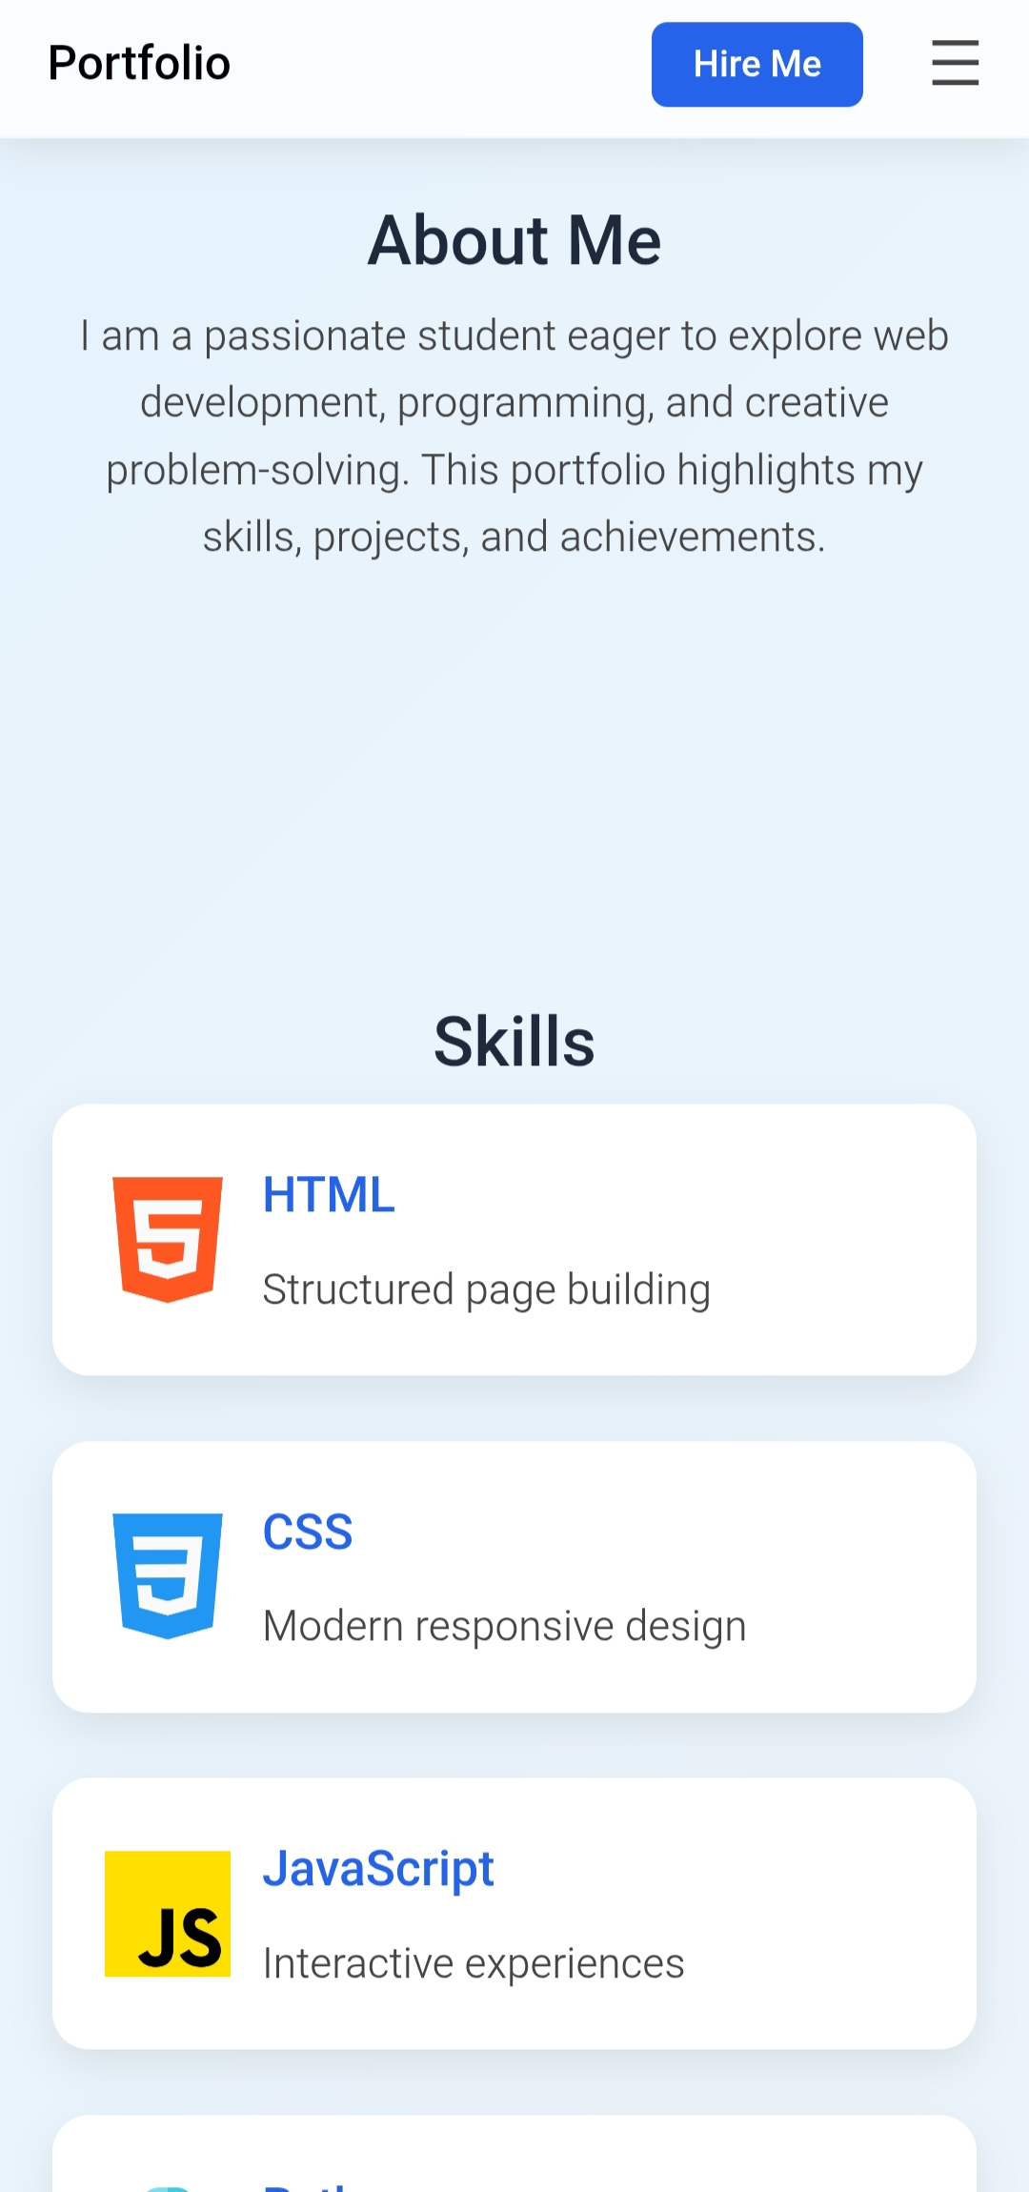
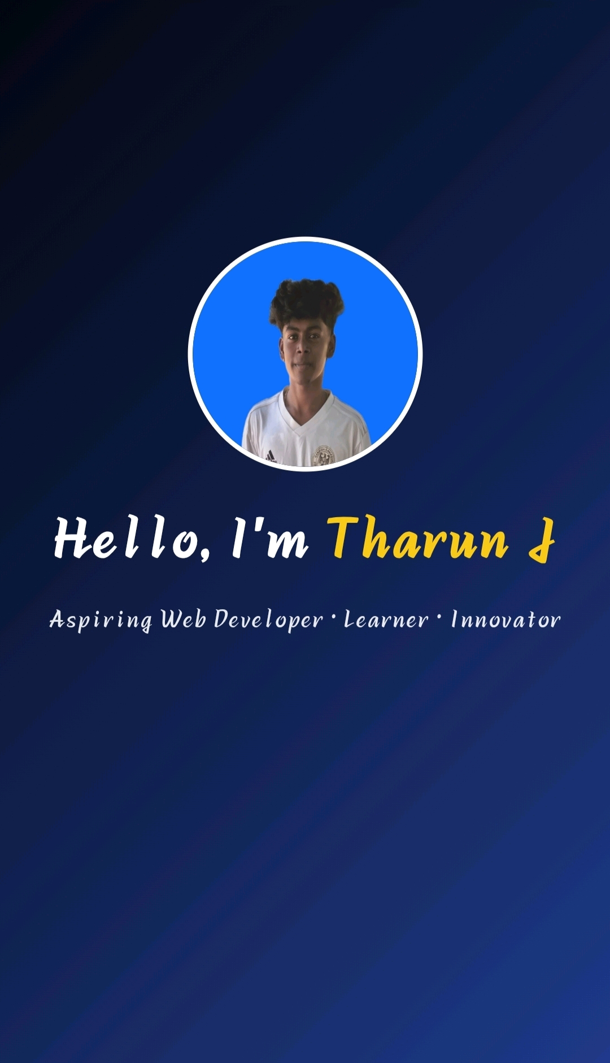
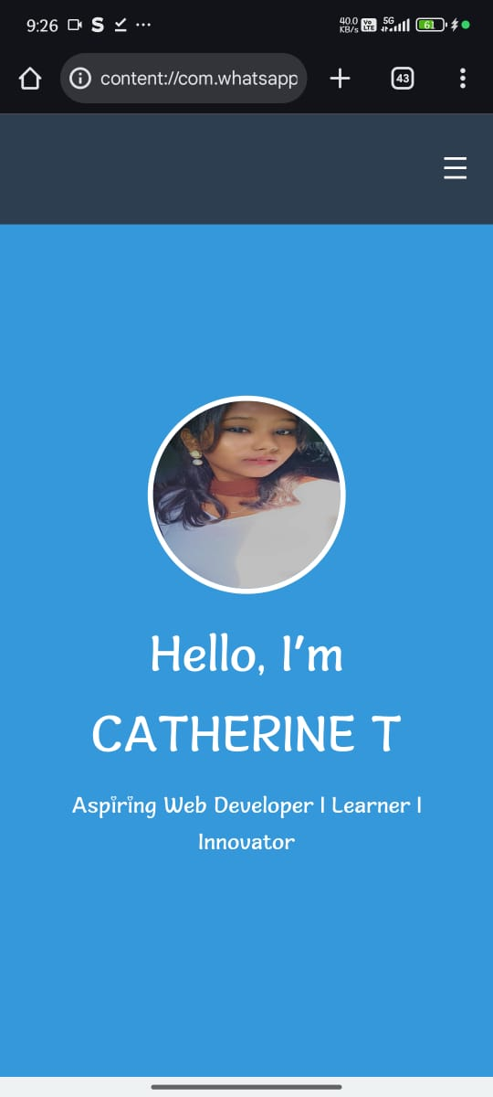
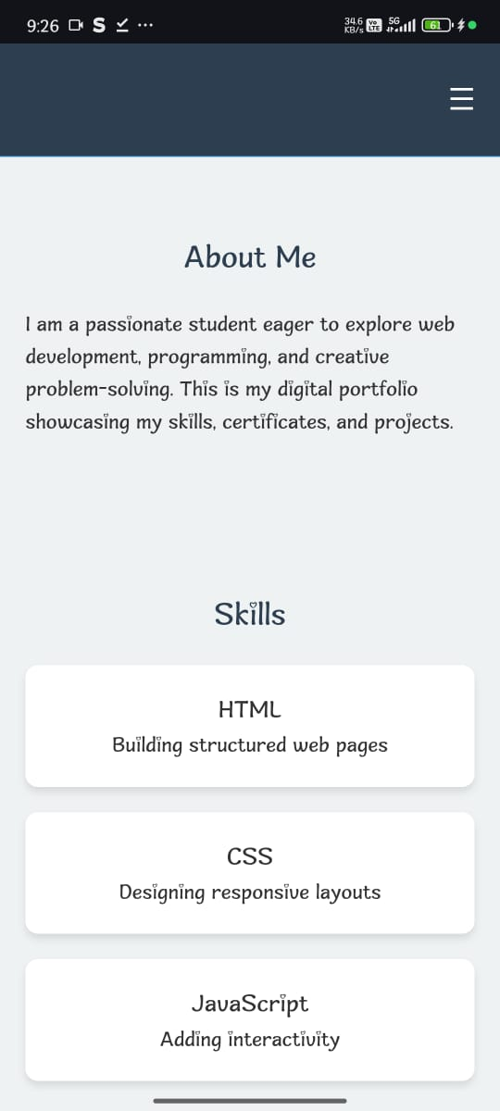
Results and Screenshots

Slide 11
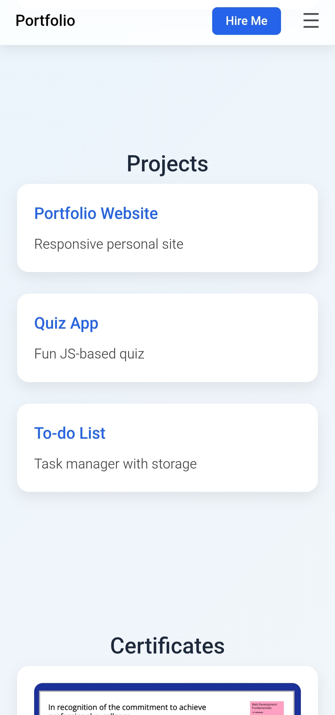
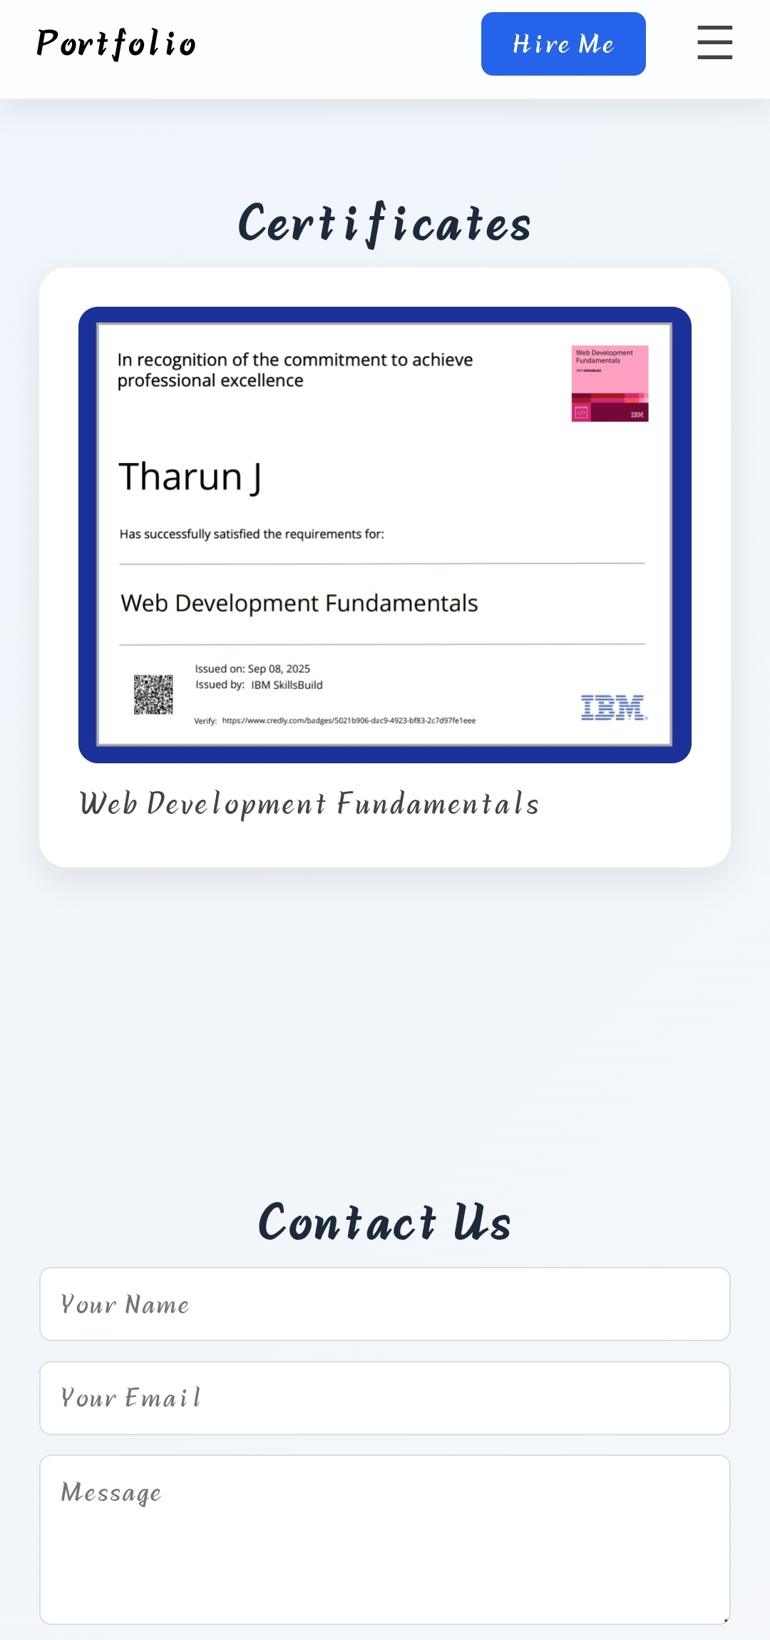
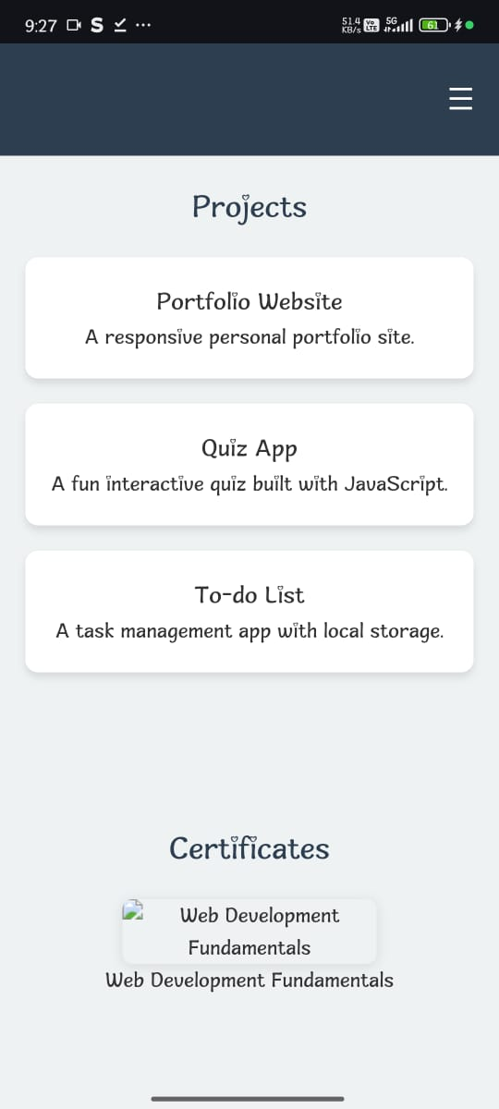
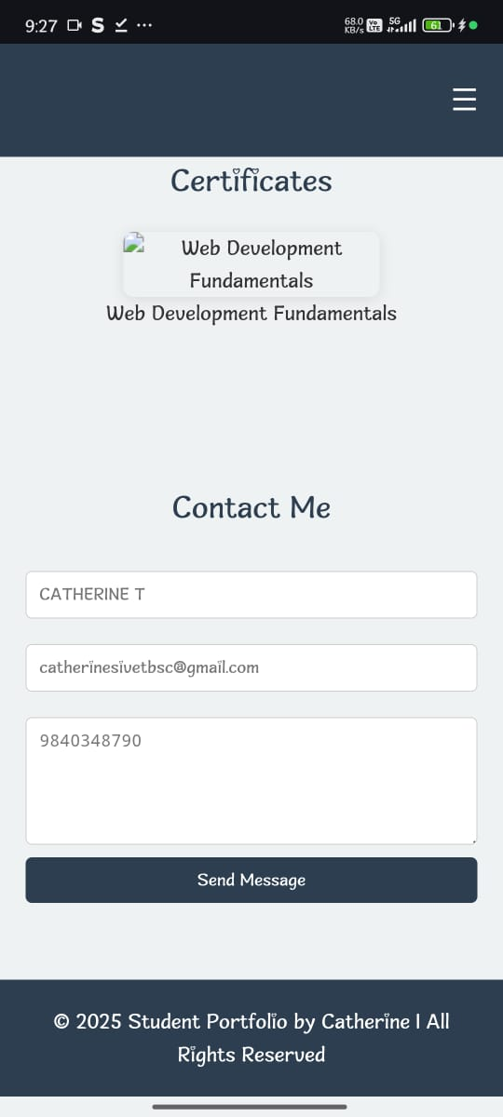
Results and Screenshots

Slide 12
Conclusion
This portfolio is an effective way to present personal skills, projects, and accomplishments.
It serves as a stepping stone for career development and personal branding in the digital space.

Slide 13
GitHub Link
Check out the project on GitHub:
https://github.com/tharunj-coder/Portfolio.git
Feel free to explore, give feedback, and collaborate!

